Slide 1
SYSTEMC PROCESS
[MCU Modelling Team] [Anh-Duc Nguyen]

Slide 2
What can we achieve
Get more familiar with SystemC process
Improve design skill

Slide 3
Agenda
1. Detail process in SystemC:
1.1 SC_METHOD
1.1.1. Overview, usage, some notes in SC_METHOD
1.1.2. When use SC_METHOD?
1.1.3 Example
1.2 SC_THREAD
1.2.1. Overview, usage, some notes in SC_THREAD
1.2.2. When use SC_THREAD?
1.2.3 Example
1.3 sc_spawn
1.3.1. Overview, usage, some notes in sc_spawn
1.3.2. When use sc_spawn?
1.2.3 Example
2. Event & Processes:
2.1 Concurrency and Time + Example explain
2.2 Cancel event
2.3 sc_process_handle():
- sc_process_handle::reset()
- sc_process_handle::suspend()
- sc_process_handle::resume()
3. Multi process with SC_MUTEX
3.1 What is mutex
3.2 When use mutex
3.3 Usage
3.4 Some examples +
4. Multi process with SC_SEMAPHORE + Example explain

Slide 4
I. Basics knowledge about Process in SystemC:
Process macros:
An unspawned process instance is a process created by invoking one of the following three process macros:
SC_METHOD
SC_THREAD
SC_CTHREAD
Spawned processes may be created by calling the function sc_spawn during elaboration or simulation.
The purpose of the process macros is to register the associated function
with the kernel such that the scheduler can call back that member function during simulation.
It is also possible to use spawned processes for this same purpose.

Slide 5
I. Basics knowledge about Process in SystemC:
Notes:
- Processes are not called directly from user code. - A process is invoked based on its sensitivity list, which consists of zero, one, or more events, which can change during simulation run time.

Slide 6
Declaration syntax:
SC_MODULE (my_module) {
void my_proc_thread(); //member function declaration
void my_proc_method(); //member function declaration
SC_CTOR (my_module) {
// thread process declaration and registration
SC_THREAD (my_proc_thread);
// method process declaration and registration
SC_METHOD (my_proc_method());
…
}
…
};

Slide 7
Process static sensitivity
SC_MODULE (my_module) {
sc_event event_1;
sc_event event_2;
void my_proc_thread(); //member function declaration
void my_proc_method(); //member function declaration
SC_CTOR (my_module) {
// thread process declaration and registration
SC_THREAD (my_proc_thread);
sensitive << event_1;
// method process declaration and registration
SC_METHOD (my_proc_method);
sensitive << event_2
}
…
};

Slide 8
Process static sensitivity
Functional Notation Syntax
Streaming Style Notation Syntax
Sensitive << event_1 << event_2 << ... ;
Single event
Multil event
sensitive (event);
sensitive (event_1);
sensitive (event_2);
sensitive (event_3);
...
SC_MODULE (my_module) {
sc_event c;
sc_event d;
void my_thread_proc ();
SC_CTOR (my_module) {
SC_THREAD (my_thread_proc);
// declare static sensitivity list
sensitive (c); // sensitive to event c
sensitive (d); // sensitive to event d
}
...
};

Slide 9
Different b/w SC_METHOD and SC_THREAD
SC_METHOD
SC_THREAD
A method process is invoked many times
Consumes no simulated time
Can not be susupended
Can not call code that calls wait()
Does not have its own thread of execution
A thread process is invoked only once
May consume simulated time
Can be susupended
Can call code that calls wait()
Has its own thread of execution

Slide 10
Different b/w SC_METHOD and SC_THREAD
Example:
Module:
SC_MODULE (Example_Moudle)
{
sc_in<bool> clock;
void Func_A (void) {
std::cout << "[" << sc_time_stamp () << "]\t" << " Func_A run " << std::endl;
}
void Func_B (void) {
std::cout << "[" << sc_time_stamp () << "]\t" << " Func_B run " << std::endl;
}
SC_HAS_PROCESS (Example_Moudle);
Example_Moudle (sc_module_name name) : sc_module (name)
{
SC_METHOD (Func_A);
sensitive << clock.pos ();
dont_initialize ();
SC_THREAD (Func_B);
sensitive << clock.pos ();
dont_initialize ();
}
};
Test bench:
int sc_main (int argc, char* argv[])
{
sc_clock Clock ("clock", 1, SC_NS, 0.5);
Example_Moudle* Example_Moudle_instance = new Example_Moudle ("Example_Moudle_instance");
Example_Moudle_instance->clock (Clock);
sc_start (5, SC_NS);
sc_stop ();
return 0;
}

Slide 11
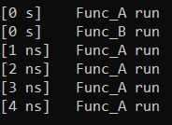
Different b/w SC_METHOD and SC_THREAD
clock
1NS
1NS
1NS
1NS
1NS
OUTPUT
...
SC_HAS_PROCESS (Example_Moudle);
Example_Moudle (sc_module_name name) : sc_module (name)
{
SC_METHOD (Func_A);
sensitive << clock.pos ();
dont_initialize ();
SC_THREAD (Func_B);
sensitive << clock.pos ();
dont_initialize ();
}
...

Slide 12
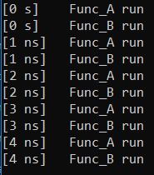
Different b/w SC_METHOD and SC_THREAD
SC_MODULE (Example_Moudle)
{
sc_in<bool> clock;
void Func_A (void) {
std::cout << "[" << sc_time_stamp () << "]\t" << " Func_A run " << std::endl;
}
void Func_B (void) {
while (true)
{
std::cout << "[" << sc_time_stamp () << "]\t" << " Func_B run " << std::endl;
wait (); // wait sensitive list
}
}
SC_HAS_PROCESS (Example_Moudle);
Example_Moudle (sc_module_name name) : sc_module (name)
{
SC_METHOD (Func_A);
sensitive << clock.pos ();
dont_initialize ();
SC_THREAD (Func_B);
sensitive << clock.pos ();
dont_initialize ();
}
};
OUTPUT

Slide 13
Different b/w SC_METHOD and SC_THREAD
Example 1:
Module:
SC_MODULE (Example_Moudle)
{
...
void Func_A_method (void) {
std::cout << "[" << sc_time_stamp () << "]\t" << " Func_A run " << std::endl;
}
void Func_B_thread (void) {
std::cout << "[" << sc_time_stamp () << "]\t" << " Func_B run " << std::endl;
}
...
}
Consume 0 ns
Consume 0 ns

Slide 14
Different b/w SC_METHOD and SC_THREAD
Example 2:
Module:
SC_MODULE (Example_Moudle)
{
...
void Func_A_method (void) {
std::cout << "[" << sc_time_stamp () << "]\t" << " Func_A run " << std::endl;
}
void Func_B (void) {
while (true)
{
std::cout << "[" << sc_time_stamp () << "]\t" << " Func_B run " << std::endl;
wait(10,NS);
wait(); // wait sensitive list
}
...
}
Consume 0 ns
Consume simulated time

Slide 15
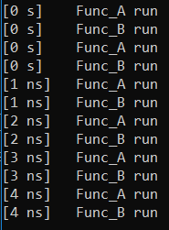
dont_initialize()
Module:
SC_MODULE (Example_Moudle)
{
sc_in<bool> clock;
void Func_A (void) {
std::cout << "[" << sc_time_stamp () << "]\t" << " Func_A run " << std::endl;
}
void Func_B (void) {
while(true)
{
std::cout << "[" << sc_time_stamp () << "]\t" << " Func_B run " << std::endl;
wait();
}
}
SC_HAS_PROCESS (Example_Moudle);
Example_Moudle (sc_module_name name) : sc_module (name)
{
SC_METHOD (Func_A);
sensitive << clock.pos ();
//dont_initialize ();
SC_THREAD (Func_B);
sensitive << clock.pos ();
//dont_initialize ();
}
};
Test bench:
int sc_main (int argc, char* argv[])
{
...
sc_start (5, SC_NS);
...
sc_stop ();
return 0;
}
OUTPUT
Initialization
phase
Triggered
by
event

Slide 16
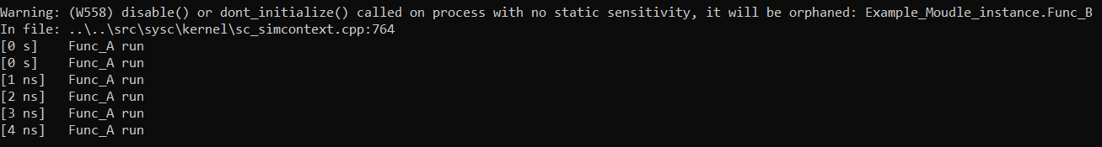
dont_initialize()
Module:
SC_MODULE (Example_Moudle)
{
sc_in<bool> clock;
void Func_A (void) {
std::cout << "[" << sc_time_stamp () << "]\t" << " Func_A run " << std::endl;
}
void Func_B (void) {
while(true)
{
std::cout << "[" << sc_time_stamp () << "]\t" << " Func_B run " << std::endl;
wait();
}
}
SC_HAS_PROCESS (Example_Moudle);
Example_Moudle (sc_module_name name) : sc_module (name)
{
SC_METHOD (Func_A);
sensitive << clock.pos ();
//dont_initialize ();
SC_THREAD (Func_B);
//sensitive << clock.pos ();
dont_initialize ();
}
};
Test bench:
int sc_main (int argc, char* argv[])
{
...
sc_start (5, SC_NS);
...
sc_stop ();
return 0;
}
OUTPUT

Slide 17
The order of execution of processes:
- The order of execution of processes is unspecified. The order of execution
between processes is deterministic.
- This means that two simulation runs using
the same version of the same simulator must yield identical results.
- However, different versions or a different simulator may yield a different result if care is not
taken when writing models
Example:
With systemc 2.3.0: Run your test case:
1st: Func_A -> Func_C -> Func_B
2nd: Func_A -> Func_C -> Func_B
3rd: Func_A -> Func_C -> Func_B
...
...
SC_HAS_PROCESS (Example_Moudle);
Example_Moudle (sc_module_name name) : sc_module (name)
{
SC_METHOD (Func_A);
sensitive << clock.pos ();
dont_initialize ();
SC_THREAD (Func_B);
sensitive << clock.pos ();
dont_initialize ();
SC_THREAD (Func_C);
sensitive << clock.pos ();
dont_initialize ();
}
...
With systemc 2.3.1: Run your test case:
1st: Func_C -> Func_A -> Func_B
2nd: Func_C -> Func_A -> Func_B
3rd: Func_C -> Func_A -> Func_B
...

Slide 18
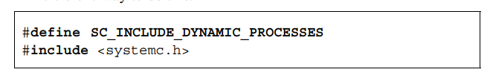
- Function sc_spawn is used to create a static or dynamic spawned process instance.
Function sc_spawn may be called during elaboration or from a static, dynamic, spawned, or unspawned process during simulation. Similarly, objects of class sc_spawn_options may be created or modified during elaboration or simulation.
- Can reset, termnate, delete, suspend,….
First, to enable dynamic processes, it is necessary to use a pre-processor macro prior to the invocation of the SystemC header file
Other mechanisms involve the C++ compilation tools. For example, GNU gcc has a –D option (e.g., –DSC_INCLUDE_DYNAMIC_PROCESSES).

Slide 19
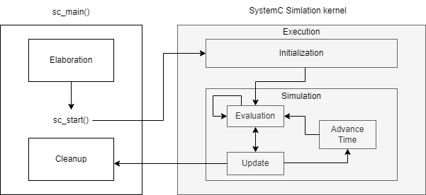
Dynamic processes

Slide 20
sc_spawn_option objname;
objname.set_stack_size(value);
objname.set_method(); //register as SC_METHOD
objname.dont_initialize();
objname.set_sensitivity(event_ptr);
objname.set_sensitivity(port_ptr);
objname.set_sensitivity(interface_ptr);
objname.set_sensitivity(event_finder_ptr);

Slide 21
Call in elaboration
SC_MODULE (Example_Moudle)
{
void process_handle_of_model(){
std::cout << "process_handle_of_model was run" << std::endl;
}
SC_HAS_PROCESS(Example_Moudle);
Example_Moudle (sc_module_name name) : sc_module (name)
{
sc_spawn_options opt;
sc_core::sc_spawn (sc_bind (&Example_Moudle::process_handle_of_model, this),
sc_core::sc_gen_unique_name ("Channel_process"), &opt);
}
};

Slide 22
NEXT_TRIGGER() for METHOD PROCESS
SC_MODULE (next_trigger_example) {
sc_in<bool> clock;
sc_event e1, e2;
int cnt;
void do_test1 () {
switch (cnt) {
next_trigger (e1);
break;
next_trigger (10, SC_NS);
break;
case 2: cout << "@" << sc_time_stamp () << " Event e1 occured or time 10ns passed" << endl;
next_trigger (e1 | e2);
break;
case 3: cout << "@" << sc_time_stamp () << " Event e1 or e2 triggered" << endl;
break;
default:cout << "@" << sc_time_stamp () << " Default trigger clk triggered" << endl;
break;
}
cnt++;
}

Slide 23
I. Elaboration and execution semantics
Example:
#include "systemc.h"
SC_MODULE(M) {
sc_in<bool> ckp;
sc_out<int> s1;
sc_signal<int> s2;
sc_event e1, e2;
SC_CTOR(M):temp(9) {
SC_THREAD(P3_thrd);
SC_THREAD(P2_thrd);
sensitive << ckp.pos();
SC_METHOD(P1_meth);
sensitive << s2;
dont_initialize();
}
~M() {};
private:
int temp;
private:
void Function1(){
P3_thrd();
}
}
Example:
#include "systemc.h"
SC_MODULE(M) {
sc_in<bool> ckp;
sc_out<int> s1;
sc_signal<int> s2;
sc_event e1, e2;
SC_CTOR(M):temp(9) {
SC_THREAD(P3_thrd);
SC_THREAD(P2_thrd);
sensitive << ckp.pos();
SC_METHOD(P1_meth);
sensitive << s2;
dont_initialize();
}
~M() {};
private:
int temp;
private:
void Function1(){
P3_thrd();
}
}
Instantiation
Process macros
23

Slide 24
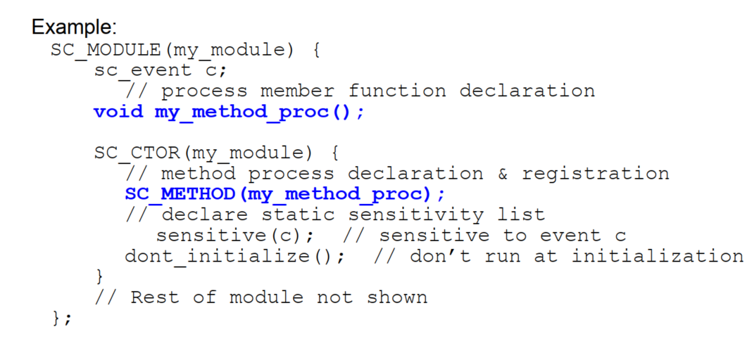
I. SC_METHOD
Example:
#include "systemc.h"
SC_MODULE(M) {
sc_in<bool> ckp;
sc_out<int> s1;
sc_signal<int> s2;
sc_event e1, e2;
SC_CTOR(M):temp(9) {
SC_THREAD(P3_thrd);
SC_THREAD(P2_thrd);
sensitive << ckp.pos();
SC_METHOD(P1_meth);
sensitive << s2;
dont_initialize();
}
~M() {};
private:
int temp;
private:
void Function1(){
P3_thrd();
}
}

Slide 25
At the same time, both READ and WRITE process access to RAM in same access address
sensitive << clock.pos()
RAM
WRITE PROCESS
address_acess = 0x12345678
sensitive << clock.pos()
address_acess = 0x12345678
READ PROCESS

Slide 26
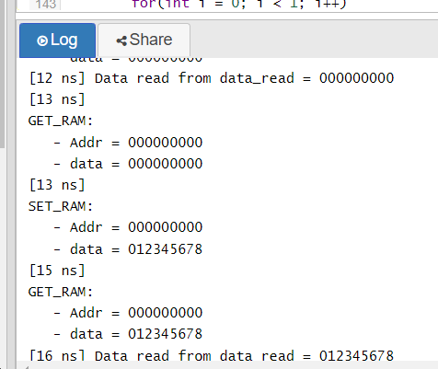
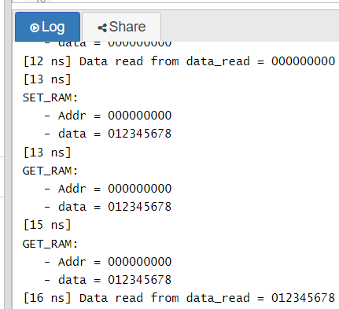
USE SC_METHOD
USE SC_THREAD

Slide 27
SystemC has two kinds of processes: method processes and thread processes. Two macros are provided to register a member function as a process: SC_METHOD and SC_THREAD. Although not strictly required, the use of these macros is strongly recommended.

Slide 28
GUIDELINE: To differentiate threads from methods, we strongly recommend adopting a naming style. One naming style appends _thread or _method as appropriate. Being able to differentiate processes based on names becomes useful during debug

Slide 29
III. Multiple processes:
1. Race condition in OS threads:
A race condition occurs when two or more threads can access shared data and they try to change it at the same time.
Because the thread scheduling algorithm can swap between threads at any time, you don't know the order in which the threads will attempt to access the shared data.
Therefore, the result of the change in data is dependent on the thread scheduling algorithm, i.e. both threads are "racing" to access/change the data.

Slide 30
III. Multiple processes:
t = 0
1. Race condition in OS threads:
Check A for $1000 received
Check B for $ 1500 received
For example: 2 threads support for user check
the account balance and withdraw cash to user.
Duc Anh’s account balance: $2000
In C++, pthread is used.
Thread A: Duc Anh go to the ATM to withdraw cash $1000
Thread B: Duc Anh’s girlfriend withdraw cash by smart phone via app – $1500
Thread A & B access to an account at about the same time.
Check account balance
Check account balance
$2000 > $1000 OK to cash
$2000 > $ 1500 OK to cash
Result:
- Duc Anh has $1000 from ATM
- Duc Anh’s girl friend has $1500 from app
- Account balance: $500
Account balance decreased to $1000
Account_balance = $1000
Account balance decreased to $500
Account_balance = $500
Operation complete
Operation complete
time

Slide 31
III. Multiple processes:
t = 0
Check A for $1000 received
If mutex was locked by A before, wait until A unlock muxtex by mutex.unlock()
Check B for $ 1500 received
1. Race condition in OS threads:
2. Use mutex to solve it:
mutex.lock()
mutex.lock()
In C++, a mutex is a lockable object
that is designed to signal when
critical sections of code need
exclusive access, preventing other threads
with the same protection from executing
concurrently and access
the same memory locations.
Check account balance
Check account balance
$2000 > $1000 OK to cash
Result:
- Duc Anh has $1000 from ATM
- Duc Anh’s girl friend has no money
- Account balance: $1000
$1000 > $ 1500 NOT OK to cash
mutex.unlock()
mutex.unlock()
Account balance decreased to $1000
Account_balance = $1000
Account balance still is $1000
Account_balance = $1000
Operation complete
Operation complete
time

Slide 32
III. Multiple processes:
1. Race condition in OS threads:
2. Use mutex to solve it:
3. What is difference b/w OS threads and SystemC threads:
- In SystemC, current implementations of SystemC run as a single thread.
- Scheduler will make processes(thread) of SystemC look like run simultaneous.
- See IEEE 1666-2011, Section 4.2.1.2:
“Since process instances execute without interruption, only a single process instance can be running at any one time, and no other process instance can execute until the currently executing process instance has yielded control to the kernel. A process shall not pre-empt or interrupt the execution of another process. This is known as co-routine semantics or co-operative multitasking.”
“The order in which process instances are selected from the set of runnable processes is implementation defined.
However, if a specific version of a specific implementation runs a specific application using a specific input data set, the order of process execution shall not vary from run to run.”

Slide 33
III. Multiple processes:
3. What is difference
b/w OS threads and
SystemC threads:
SC_THREAD A (Duc Anh)
SC_THREAD B (Duc Anh’s girl friend)
Wait event from ATM
Wait event from APP
Check A for $X received
Check B for $Y received
Check account balance
Check account balance
OK to cash or NOT?
OK to cash or NOT?
Decrease account balance if OK to cash
Decrease account balance if OK to cash
Operation complete
Operation complete

Slide 34
III. Multiple processes:
3. What is difference
b/w OS threads and
SystemC threads:
SC_THREAD A (Duc Anh)
Wait event from ATM
Check A for $X received
(ATM_amount = $1000)
void THREAD_A (void) {
while(true)
{
wait(); // wait event
isOK = check_account_balance(ATM_amount);
if(isOK)
{
return_money();
decrease_account_balance();
}
}
}
SC_THREAD(THREAD_A) << ATM_amount_event;
Check account balance
OK to cash or NOT?
Decrease account balance if OK to cash
Operation complete

Slide 35
III. Multiple processes:
SC_THREAD B (Duc Anh’s girl friend)
3. What is difference
b/w OS threads and
SystemC threads:
Wait event from APP
Check B for $Y received
(APP_amount = $1500)
void THREAD_B (void) {
while(true)
{
wait();
isOK = check_account_balance(APP_amount);
if(isOK)
{
return_money();
decrease_account_balance();
}
}
}
SC_THREAD(THREAD_B) << APP_amount_event;
Check account balance
OK to cash or NOT?
Decrease account balance if OK to cash
Operation complete

Slide 36
(ATM_amount = $1000)
void THREAD_A (void) {
while(true)
{
wait();
isOK = check_account_balance(ATM_amount);
if(isOK)
{
return_money();
decrease_account_balance();
}
}
}
SC_THREAD(THREAD_A) << ATM_amount_event;
III. Multiple processes:
3. What is difference
b/w OS threads and
SystemC threads:
Example1:
Test bench:
int sc_main(int argc, char* argv[])
{
…
sc_start(5,NS);
…
ATM_amount_event.notify();
APP_amount_event.notify();
sc_start();
…
sc_stop();
return 0;
}
(APP_amount = $1500)
void THREAD_B (void) {
while(true)
{
wait();
isOK = check_account_balance(APP_amount);
if(isOK)
{
return_money();
decrease_account_balance();
}
}
}
SC_THREAD(THREAD_B) << APP_amount_event;

Slide 37
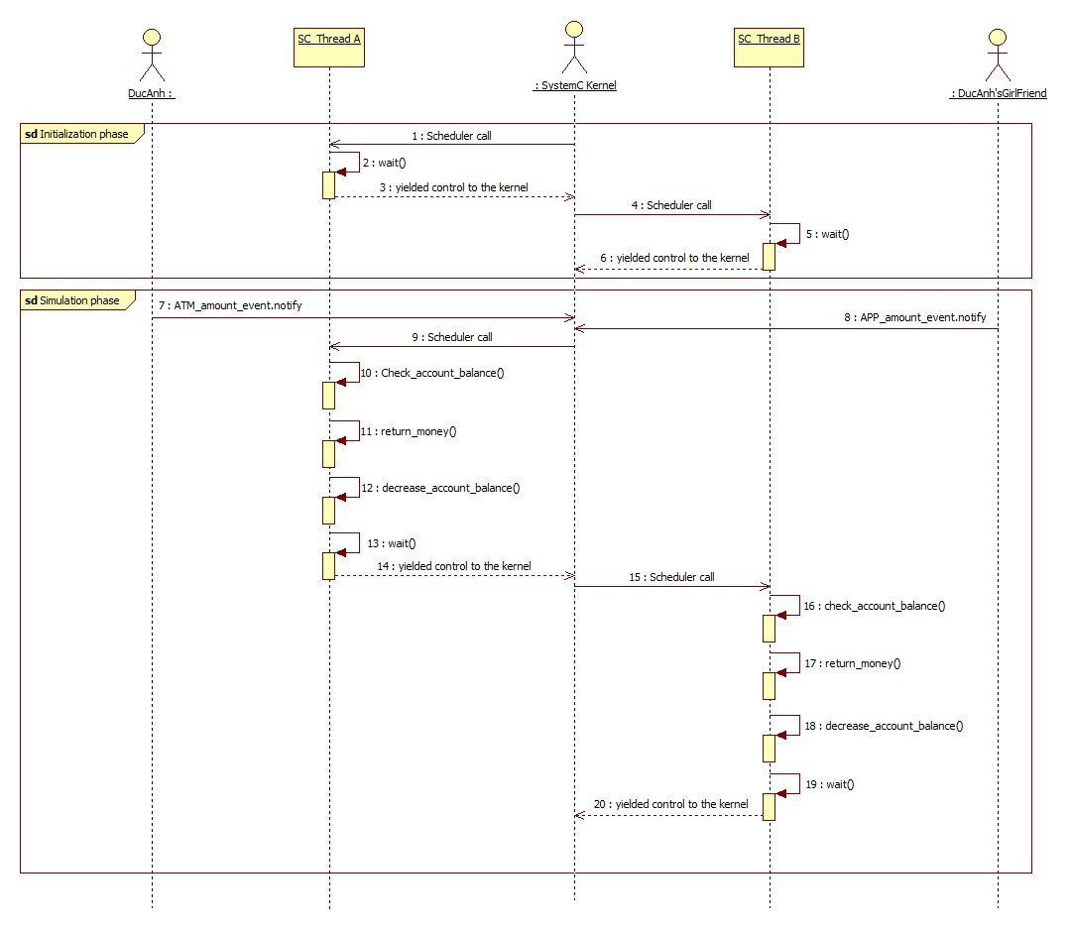
Example1:
III. Multiple processes:
non-deterministic
3. What is difference
b/w OS threads and
SystemC threads:
t = 5 NS
(7) -> (20): Simulation_time consumed = 0 NS
=> Thread A, B run at the same time
(simulation time)
Runnable
Running
Waiting
Th_A
t = 5 NS
Th_B

Slide 38
Example1:
III. Multiple processes:
3. What is difference
b/w OS threads and
SystemC threads:
t = 5 NS
(1) -> (20): Simulation_time consumed = 0 NS
=> Thread A, B run at the same time
(simulation time)
Runnable
Running
Waiting
Th_A
t = 5 NS
Th_B

Slide 39
Example1:
III. Multiple processes:
3. What is difference
b/w OS threads and
SystemC threads:
t = 5 NS
(1) -> (20): Simulation_time consumed = 0 NS
=> Thread A, B run at the same time
(simulation time)
Runnable
Running
Waiting
Th_A
t = 5 NS
Th_B

Slide 40
Example1:
III. Multiple processes:
3. What is difference
b/w OS threads and
SystemC threads:
t = 5 NS
(1) -> (20): Simulation_time consumed = 0 NS
=> Thread A, B run at the same time
(simulation time)
Runnable
Running
Waiting
Th_B
Th_A
t = 5 NS

Slide 41
Example1:
III. Multiple processes:
3. What is difference
b/w OS threads and
SystemC threads:
t = 5 NS
(1) -> (20): Simulation_time consumed = 0 NS
=> Thread A, B run at the same time
(simulation time)
Runnable
Running
Waiting
Th_B
t = 5 NS
Th_A

Slide 42
(ATM_amount = $1000)
void THREAD_A (void) {
while(true)
{
wait();
isOK = check_account_balance(ATM_amount);
if(isOK) {
wait(SC_ZERO_TIME);
return_money();
decrease_account_balance();
}
}
}
SC_THREAD(THREAD_A) << ATM_amount_event;
III. Multiple processes:
3. What is difference
b/w OS threads and
SystemC threads:
Example2:
Test bench:
int sc_main(int argc, char* argv[])
{
…
sc_start(5,NS);
…
ATM_amount_event.notify();
APP_amount_event.notify();
sc_start();
…
sc_stop();
return 0;
}
(APP_amount = $1500)
void THREAD_B (void) {
while(true)
{
wait();
isOK = check_account_balance(APP_amount);
if(isOK){
wait(SC_ZERO_TIME);
return_money();
decrease_account_balance();
}
}
}
SC_THREAD(THREAD_B) << APP_amount_event;

Slide 43
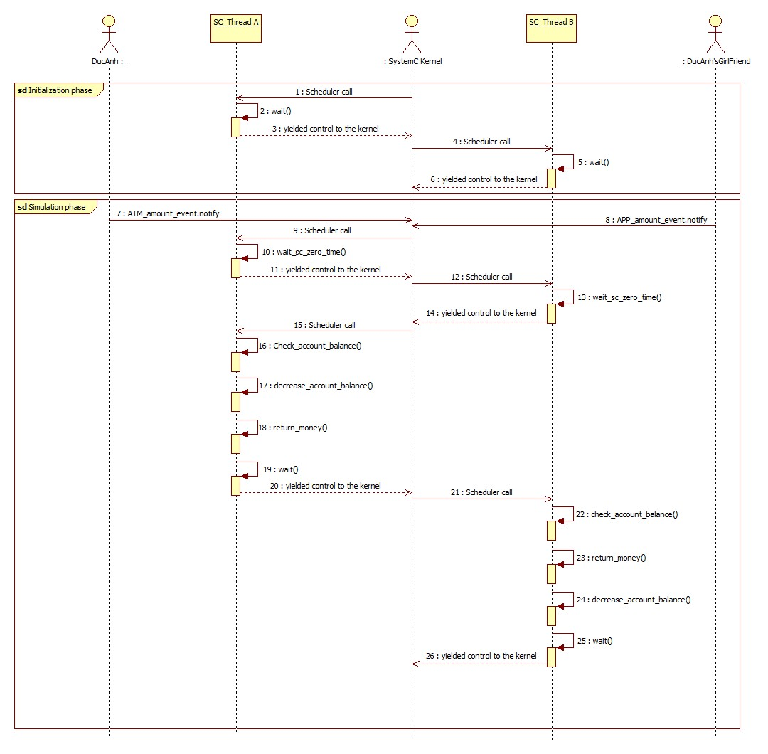
Example2:
III. Multiple processes:
3. What is difference
b/w OS threads and
SystemC threads:
t = 5 NS
(7) -> (26): Simulation_time consumed = 0 NS
=> Thread A, B run at the same time
(simulation time)
Runnable
Running
Waiting
Th_A
Th_B
t = 5 NS

Slide 44
Example2:
III. Multiple processes:
3. What is difference
b/w OS threads and
SystemC threads:
t = 5 NS
(7) -> (26): Simulation_time consumed = 0 NS
=> Thread A, B run at the same time
(simulation time)
Runnable
Running
Waiting
Th_A
Th_B
t = 5 NS

Slide 45
Example2:
III. Multiple processes:
3. What is difference
b/w OS threads and
SystemC threads:
t = 5 NS
(7) -> (26): Simulation_time consumed = 0 NS
=> Thread A, B run at the same time
(simulation time)
Runnable
Running
Waiting
Th_A
SC_ZERO_TIME
Th_B
t = 5 NS

Slide 46
Example2:
III. Multiple processes:
3. What is difference
b/w OS threads and
SystemC threads:
t = 5 NS
(7) -> (26): Simulation_time consumed = 0 NS
=> Thread A, B run at the same time
(simulation time)
Runnable
Running
Waiting
Th_B
Th_A
SC_ZERO_TIME
t = 5 NS

Slide 47
Example2:
III. Multiple processes:
3. What is difference
b/w OS threads and
SystemC threads:
t = 5 NS
(7) -> (26): Simulation_time consumed = 0 NS
=> Thread A, B run at the same time
(simulation time)
Runnable
Running
Waiting
Th_B
SC_ZERO_TIME
Th_A
SC_ZERO_TIME
t = 5 NS

Slide 48
Example2:
III. Multiple processes:
3. What is difference
b/w OS threads and
SystemC threads:
t = 5 NS
(7) -> (26): Simulation_time consumed = 0 NS
=> Thread A, B run at the same time
(simulation time)
Runnable
Running
Waiting
Th_A
Th_B
t = 5 NS

Slide 49
Example2:
III. Multiple processes:
3. What is difference
b/w OS threads and
SystemC threads:
t = 5 NS
(7) -> (26): Simulation_time consumed = 0 NS
=> Thread A, B run at the same time
(simulation time)
Runnable
Running
Waiting
Th_A
Th_B
t = 5 NS

Slide 50
Example2:
III. Multiple processes:
3. What is difference
b/w OS threads and
SystemC threads:
t = 5 NS
(7) -> (26): Simulation_time consumed = 0 NS
=> Thread A, B run at the same time
(simulation time)
Runnable
Running
Waiting
Th_A
DONE
Th_B
t = 5 NS

Slide 51
Example2:
III. Multiple processes:
3. What is difference
b/w OS threads and
SystemC threads:
t = 5 NS
(7) -> (26): Simulation_time consumed = 0 NS
=> Thread A, B run at the same time
(simulation time)
Runnable
Running
Waiting
Th_B
Th_A
DONE
t = 5 NS

Slide 52
Example2:
III. Multiple processes:
3. What is difference
b/w OS threads and
SystemC threads:
t = 5 NS
(7) -> (26): Simulation_time consumed = 0 NS
=> Thread A, B run at the same time
(simulation time)
Runnable
Running
Waiting
Th_B
DONE
Th_A
DONE
t = 5 NS

Slide 53
(ATM_amount = $1000)
void THREAD_A (void) {
while(true)
{
wait();
isOK = check_account_balance(ATM_amount);
if(isOK) {
return_money();
wait(SC_ZERO_TIME);
decrease_account_balance();
}
}
}
SC_THREAD(THREAD_A) << ATM_amount_event;
III. Multiple processes:
3. What is difference
b/w OS threads and
SystemC threads:
Example3:
Test bench:
int sc_main(int argc, char* argv[])
{
…
sc_start(5,NS);
…
ATM_amount_event.notify();
APP_amount_event.notify();
sc_start();
…
sc_stop();
return 0;
}
(APP_amount = $1500)
void THREAD_B (void) {
while(true)
{
wait();
isOK = check_account_balance(APP_amount);
if(isOK){
return_money();
wait(SC_ZERO_TIME);
decrease_account_balance();
}
}
}
SC_THREAD(THREAD_B) << APP_amount_event;

Slide 54
III. Multiple processes:
3. What is difference
b/w OS threads and
SystemC threads:
What is diff b/w Example1,2 and Example 3 ?

Slide 55
III. Multiple processes:
3. What is difference
b/w OS threads and
SystemC threads:
What is diff b/w Example1,2 and Example 3 ?
Result of Example1,2:
DucAnh has $1000 at t = 5 NS
DucAnh’s girl friend has No money because Account_ballance = $1000 < request($1500)
Result of Example 3:
DucAnh has $1000 at t = 5 NS
DucAnh’s girl friend has $1500 at t = 5 NS

Slide 56
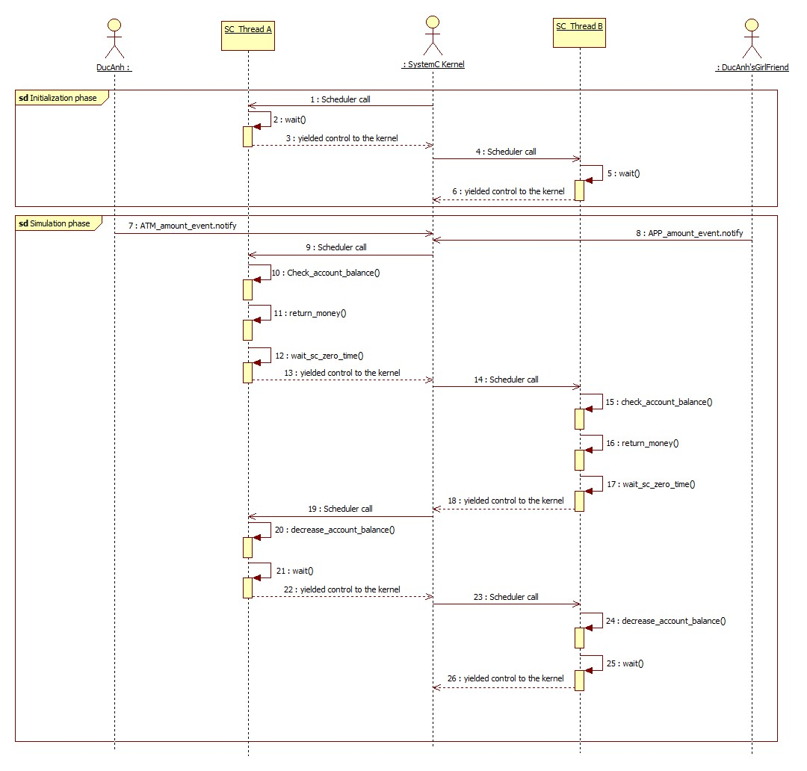
III. Multiple processes:
Example3:
3. What is difference
b/w OS threads and
SystemC threads:
Return $1000 for DUC ANH
RACE condition occurs
Check Account_balance is still $2000,
Return $1500 for DUCANH’s girl friend

Slide 57
III. Multiple processes:
Example3:
3. What is difference
b/w OS threads and
SystemC threads:
Thread A read/write Account_balance
Thread B read/write Account_balance

Slide 58
Example4:
(ATM_amount = $1000)
void THREAD_A(void) {
while (true)
{
wait();
sysC_mutex.lock();
isOK = check_account_balance(ATM_amount);
if (isOK) {
return_money();
wait(SC_ZERO_TIME);
decrease_account_balance();
}
sysC_mutex.unlock();
}
}
SC_THREAD(THREAD_A) << ATM_amount_event;
III. Multiple processes:
4. Use sc_mutex to solve it:
In SystemC, a sc_mutex
also same idea with mutex of C++,
used for exclusive access control
proceses in SystemC.
Test bench:
sc_mutex sysC_mutex;
int sc_main(int argc, char* argv[])
{
…
sc_start(5,NS);
…
ATM_amount_event.notify();
APP_amount_event.notify();
sc_start();
…
sc_stop();
return 0;
}
(APP_amount = $1500)
void THREAD_B(void) {
while (true)
{
wait();
sysC_mutex.lock();
isOK = check_account_balance(APP_amount);
if (isOK) {
return_money();
wait(SC_ZERO_TIME);
decrease_account_balance();
}
sysC_mutex.unlock();
}
}
SC_THREAD(THREAD_B) << APP_amount_event;

Slide 59
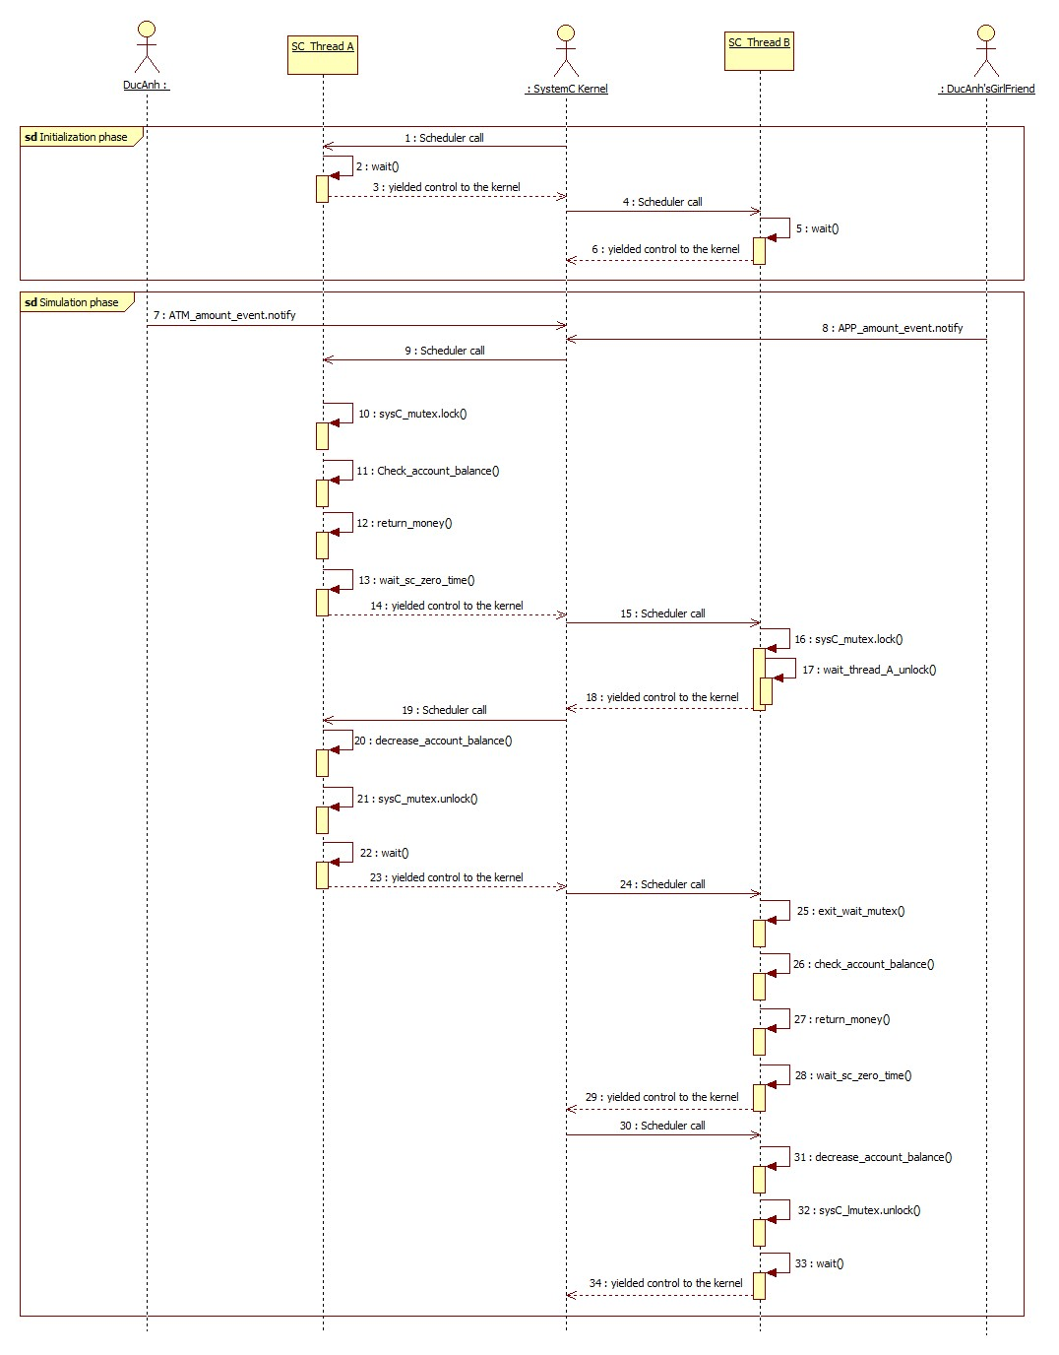
Example4:
III. Multiple processes:
4. Use sc_mutex to solve it:
t = 5 NS
Thread A read/write Account_balance
Thread B read/write Account_balance
t = 5 NS

Slide 60
III. Multiple processes:
4. Use sc_mutex to solve it:
- Can not be used in SC_METHOD process
- Methods of sc_mutex:
+ lock(): Blocks until mutex can be locked
+ unlock(): Gives up mutex ownership, returns int, -1 if
mutex was not locked by caller
+ trylock(): Nonblocking, returns 0 if lock
successful, -1 otherwise
+ kind(): Returns string “sc_mutex”
5. Difference lock() and trylock():

Slide 61
(ATM_amount = $1000)
void THREAD_A(void) {
while (true)
{
wait();
if (sysC_mutex.trylock() == 0) {
isOK = check_account_balance(ATM_amount);
if (isOK) {
return_money();
wait(SC_ZERO_TIME);
decrease_account_balance();
}
sysC_mutex.unlock();
}
else cout << "System is busy, please try it again";
}
}SC_THREAD(THREAD_A) << ATM_amount_event;
III. Multiple processes:
5. Difference lock() and trylock():
Test bench:
sc_mutex sysC_mutex;
int sc_main(int argc, char* argv[])
{
…
sc_start(5,NS);
…
ATM_amount_event.notify();
APP_amount_event.notify();
sc_start();
…
sc_stop();
return 0;
}
(APP_amount = $1500)
void THREAD_A(void) {
while (true)
{
wait();
if (sysC_mutex.trylock() == 0) {
isOK = check_account_balance(ATM_amount);
if (isOK) {
return_money();
wait(SC_ZERO_TIME);
decrease_account_balance();
}
sysC_mutex.unlock();
}
else cout << "System is busy, please try it again";
}
}SC_THREAD(THREAD_B) << APP_amount_event;

Slide 62
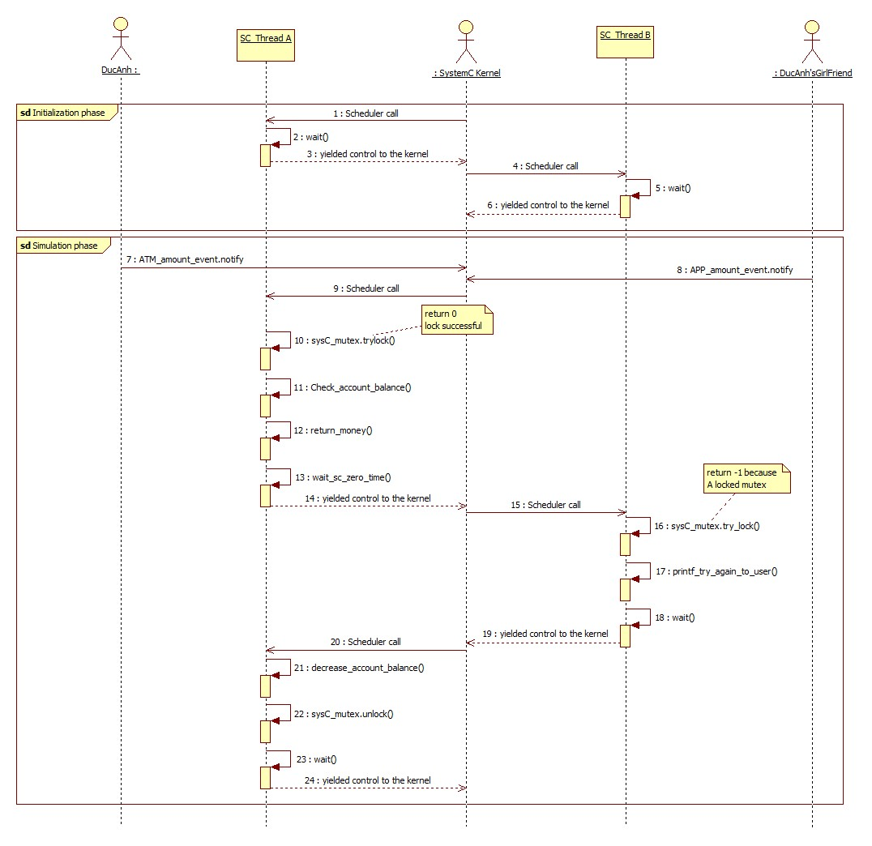
III. Multiple processes:
5. Difference lock() and trylock():
Thread A read/write Account_balance
Thread B notify to user try again

Slide 63
III. Multiple processes:
5. Difference lock() and trylock():
lock()
trylock()
- If mutex does not locked by other,
thread will lock mutex
- If mutex was locked by other thread, current thread will
wait(suspend) until other thread unlock which locked mutex
- If mutex does not locked by other thread,
thread will lock mutex and return 0
- If mutex was locked by other thread, current thread NOT wait(suspend),
thread can execute next statement. You can base on return value(-1) to
determine next behavior for this thread.

Slide 64
III. Multiple processes:
5. Deadlock:
Deadlock is a situation where a set of processes are blocked because each process is holding a resource and waiting for another resource acquired by some other process.
Forgot unlock()
Circular Wait

Slide 65
(ATM_amount = $1000)
void THREAD_A(void) {
while (true)
{
wait();
sysC_mutex.lock();
isOK = check_account_balance(ATM_amount);
if (isOK) {
return_money();
wait(SC_ZERO_TIME);
decrease_account_balance();
}
sysC_mutex.unlock();
}
}
SC_THREAD(THREAD_A) << ATM_amount_event;
III. Multiple processes:
5. Deadlock:
Forgot unlock()
Test bench:
sc_mutex sysC_mutex;
int sc_main(int argc, char* argv[])
{
…
sc_start(5,NS);
…
ATM_amount_event.notify();
APP_amount_event.notify();
sc_start();
…
sc_stop();
return 0;
}
(APP_amount = $1500)
void THREAD_B(void) {
while (true)
{
wait();
sysC_mutex.lock();
isOK = check_account_balance(APP_amount);
if (isOK) {
return_money();
wait(SC_ZERO_TIME);
decrease_account_balance();
}
sysC_mutex.unlock();
}
}
SC_THREAD(THREAD_B) << APP_amount_event;

Slide 66
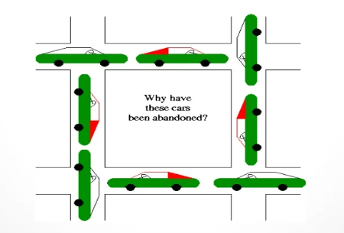
III. Multiple processes:
5. Deadlock:
Circular Wait

Slide 67
III. Multiple processes:
5. Deadlock:
void THREAD_A(void) {
while (true)
{
wait();
sysC_mutex_1.lock();
wait(SC_ZERO_TIME);
sysC_mutex_2.lock();
…
sysC_mutex_2.unlock();
sysC_mutex_1.unlock();
}
}
Circular Wait
Test bench:
sc_mutex sysC_mutex_1;
sc_mutex sysC_mutex_2;
int sc_main(int argc, char* argv[])
{
…
sc_start(5,NS);
…
ATM_amount_event.notify();
APP_amount_event.notify();
sc_start();
…
sc_stop();
return 0;
}
void THREAD_B(void) {
while (true)
{
wait();
sysC_mutex_2.lock();
wait(SC_ZERO_TIME);
sysC_mutex_1.lock();
…
sysC_mutex_1.unlock();
sysC_mutex_2.unlock();
}
}

Slide 68
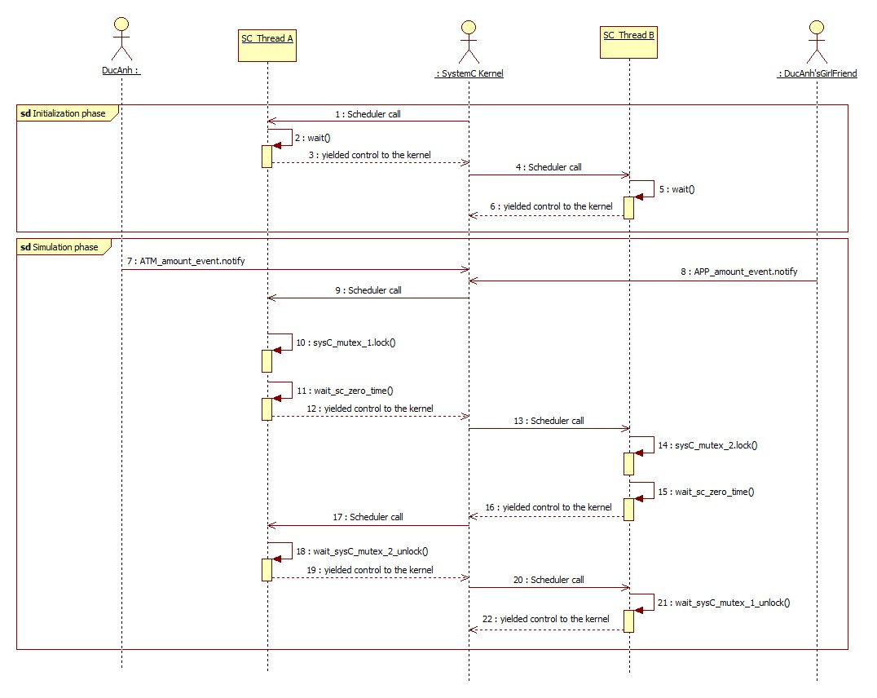
III. Multiple processes:
5. Deadlock:
Circular Wait
DEADLOCK

Slide 69
III. Multiple processes:
5. Semaphore:
Class sc_semaphore is a predefined channel intended to model the behavior of a software semaphore used to provide limited concurrent access to a shared resource. A semaphore has an integer value, the semaphore value, which is set to the permitted number of concurrent accesses when the semaphore is constructed.
Number of concurrent users:
In sc_main: sc_semaphore s(4)
In a module: SC_CTOR(module_name): s(4) { … };
Binary semaphore
Counting semaphore

Slide 70
(ATM_amount = $1000)
void THREAD_A(void) {
while (true)
{
wait();
s.wait();
isOK = check_account_balance(ATM_amount);
if (isOK) {
return_money();
wait(SC_ZERO_TIME);
decrease_account_balance();
}
s.post();
}
}
SC_THREAD(THREAD_A) << ATM_amount_event;
III. Multiple processes:
Assume Thread_A run ahead
5. Semaphore:
(1) “sem_value” = 1 – 1 = 0
Binary semaphore: sc_semaphore s(1)
Initial value
(3) “sem_value” = 0 + 1 = 1
Test bench:
sc_semaphore s(1);
int sc_main(int argc, char* argv[])
{
…
sc_start(5,NS);
…
ATM_amount_event.notify();
APP_amount_event.notify();
sc_start();
…
sc_stop();
return 0;
}
(APP_amount = $1500)
void THREAD_B(void) {
while (true)
{
wait();
s.wait();
isOK = check_account_balance(APP_amount);
if (isOK) {
return_money();
wait(SC_ZERO_TIME);
decrease_account_balance();
}
s.post();
}
}
SC_THREAD(THREAD_B) << APP_amount_event;
Assume Thread_B run after A
(2) sem_value = 0;
wait until “sem_value” become 1
(4) Then “sem_value” = 1 – 1 = 0
(5) “sem_value” = 0 + 1 = 1

Slide 71
III. Multiple processes:
5. Semaphore:
Binary semaphore: sc_semaphore s(1)
=> Binary semaphore ~ sc_mutex
But has a little difference
sc_mutex
Binary semaphore
- Mutex has “owner”
- Only the thread that obtained the lock can unlock mutex.
- Semaphore has no “owner”
- Semaphores need not be acquired and be released by the same thread.

Slide 72
(ATM_amount = $1000)
void THREAD_A(void) {
while (true)
{
wait();
s.wait();
isOK = check_account_balance(ATM_amount);
if (isOK) {
return_money();
wait(SC_ZERO_TIME);
decrease_account_balance();
}
s.post();
}
}
SC_THREAD(THREAD_A) << ATM_amount_event;
III. Multiple processes:
5. Semaphore:
(1) “sem_value” = 1 – 1 = 0
Developer should manage the couple wait() & post() to prevent the mem_value exceed initial value
It may be cause potential bugs
Binary semaphore: sc_semaphore s(1)
Initial value
(4) “sem_value” = 0 + 1 = 1
Test bench:
sc_semaphore s(1);
int sc_main(int argc, char* argv[])
{
…
sc_start(5,NS);
…
ATM_amount_event.notify();
APP_amount_event.notify();
sc_start();
…
sc_stop();
return 0;
}
(APP_amount = $1500)
void THREAD_B(void) {
while (true)
{
wait();
s.post();
s.wait();
isOK = check_account_balance(APP_amount);
if (isOK) {
return_money();
wait(SC_ZERO_TIME);
decrease_account_balance();
}
s.post();
}
}
SC_THREAD(THREAD_B) << APP_amount_event;
See IEEE 1666-2011, Section 6.29.3:
Note1: The semaphore value may exceed the value set by the constructor.
(2) “sem_value” = 0 + 1 = 1
(3) “sem_value” = 1 - 1 = 0
(5) “sem_value” = 1 + 1 = 2

Slide 73
(ATM_amount = $1000)
void THREAD_A(void) {
while (true)
{
wait();
s.wait();
isOK = check_account_balance(ATM_amount);
if (isOK) {
return_money();
wait(SC_ZERO_TIME);
decrease_account_balance();
}
s.post();
}
}
SC_THREAD(THREAD_A) << ATM_amount_event;
III. Multiple processes:
Assume Thread_A run ahead
5. Semaphore:
(1) “sem_value” = 3 – 1 = 2
Counting semaphore: sc_semaphore s(3)
Initial value
(3) “sem_value” = 1 + 1 = 2
Test bench:
sc_semaphore s(3);
int sc_main(int argc, char* argv[])
{
…
sc_start(5,NS);
…
ATM_amount_event.notify();
APP_amount_event.notify();
sc_start();
…
sc_stop();
return 0;
}
(APP_amount = $1500)
void THREAD_B(void) {
while (true)
{
wait();
s.wait();
isOK = check_account_balance(APP_amount);
if (isOK) {
return_money();
wait(SC_ZERO_TIME);
decrease_account_balance();
}
s.post();
}
}
SC_THREAD(THREAD_B) << APP_amount_event;
Assume Thread_B run after A
(2) “sem_value” = 2 – 1 = 1
(5) “sem_value” = 2 + 1 = 3

Slide 74
III. Multiple processes:
5. Semaphore:
Counting semaphore:
class multiport_RAM {
sc_semaphore read_ports(3);
sc_semaphore write_ports(2);
void read(int addr, int& data) {
read_ports.wait();
// perform read
read_ports.post();
}
void write(int addr, int data) (
write_ports.wait();
// perform write
write_ports.post();
}
}; //endclass
A multi-port memory model example of
an electronic system level design application
for sc_semaphore.
You might use the semaphore to indicate the number
of read or write accesses allowed.

Slide 75
III. Multiple processes:
5. Introduce implementation of fair_mutex
(ADVANCED knowledge)
Root cause issue in CVE model:
+ Number of threads in CVE is so large (> 32)
+ Bug found when CVE setting 10 threads run parallel, concurrent access to 1 resource
+ When mutex was locked by 1 thread, remaining 9 threads will waiting for mutex.unlock()
+ When mutex.unlock(), 1 in 9 thread will take lock and run.
+ Issue: The order of thread run after unlock() mutex depends on the scheduling order of the simulation kernel, several threads pending forever.

Slide 76
III. Multiple processes:
5. Introduce implementation of fair_mutex
(ADVANCED knowledge)
Issue: The order of thread run after unlock() mutex depends on the scheduling order of the simulation kernel
Thread_1:
while(1)
{
wait();
while(1)
{
Share_Func();
}
}
Thread_2:
while(1)
{
wait();
while(1)
{
Share_Func();
}
}
sc_start()
Thread | waiting | take | release
0 | 10 | 9 | 9
1 | 20 | 19 | 19
2 | 1000 | 1000 | 1000
3 | 4 | 3 | 3
4 | 5 | 4 | 4
5 | 3 | 2 | 2
6 | 1000 | 1000 | 1000
7 | 3 | 2 | 2
8 | 1000 | 1000 | 1000
9 | 2 | 1 | 1
Share_Func()
{
sysC_mutex.lock();
…
wait(10, SC_NS);
…
sysC_mutex.unlock();
…
}
Thread_3:
while(1)
{
wait();
while(1)
{
Share_Func();
}
}
Thread_4:
while(1)
{
wait();
while(1)
{
Share_Func();
}
}
Scheduler always choose thread 2,6,8
to run after mutex.unlock()
Thread 0,1,3,4,5,7,9 is suspended forever
…
…

Slide 77
III. Multiple processes:
5. Introduce implementation of fair_mutex
(ADVANCED knowledge)
Analyze issue: We go through 3 below example to understand:
Example 1: First thread always obtain mutex, remaining threads pending forever
Example 2: Scheduler does not fair in choosing thread run in same evaluation phase
Example 3: Use fair_mutex to solve if Scheduler not fair

Slide 78
III. Multiple processes:
5. Introduce implementation of fair_mutex
(ADVANCED knowledge)
Example 1: thread 3 always obtain mutex, thread 1,2,4 pending forever
Thread_1:
while(1)
{
wait();
while(1)
{
Share_Func();
}
}
Thread_2:
while(1)
{
wait();
while(1)
{
Share_Func();
}
}
Assume, T3 is run first by scheduler
Share_Func()
{
sysC_mutex.lock();
…
wait(10, SC_NS);
…
sysC_mutex.unlock();
…
}
Evaluation phase
T3
T3
Waiting list
Thread_3:
while(1)
{
wait();
while(1)
{
Share_Func();
}
}
Thread_4:
while(1)
{
wait();
while(1)
{
Share_Func();
}
}
Int sc_mutex::lock()
{
if (m_owner == sc_get_current_process_b) return 0;
while( in_use() ) {
sc_core::wait( m_free, sc_get_curr_simcontext() );
}
m_owner = sc_get_current_process_b();
return 0;
}

Slide 79
III. Multiple processes:
5. Introduce implementation of fair_mutex
(ADVANCED knowledge)
Example 1: thread 3 always obtain mutex, thread 1,2,4 pending forever
Thread_1:
while(1)
{
wait();
while(1)
{
Share_Func();
}
}
Thread_2:
while(1)
{
wait();
while(1)
{
Share_Func();
}
}
Assume, T3 is run first by scheduler
Share_Func()
{
sysC_mutex.lock();
…
wait(10, SC_NS);
…
sysC_mutex.unlock();
…
}
Evaluation phase
T3
T3
Waiting list
Thread_3:
while(1)
{
wait();
while(1)
{
Share_Func();
}
}
Thread_4:
while(1)
{
wait();
while(1)
{
Share_Func();
}
}
Int sc_mutex::lock()
{
if (m_owner == sc_get_current_process_b) return 0;
while( in_use() ) {
sc_core::wait( m_free, sc_get_curr_simcontext() );
}
m_owner = sc_get_current_process_b();
return 0;
}

Slide 80
III. Multiple processes:
5. Introduce implementation of fair_mutex
(ADVANCED knowledge)
Example 1: thread 3 always obtain mutex, thread 1,2,4 pending forever
Thread_1:
while(1)
{
wait();
while(1)
{
Share_Func();
}
}
Thread_2:
while(1)
{
wait();
while(1)
{
Share_Func();
}
}
Assume, T3 is run first by scheduler
Share_Func()
{
sysC_mutex.lock();
…
wait(10, SC_NS);
…
sysC_mutex.unlock();
…
}
Evaluation phase
T3
T1
Waiting list
Thread_3:
while(1)
{
wait();
while(1)
{
Share_Func();
}
}
Thread_4:
while(1)
{
wait();
while(1)
{
Share_Func();
}
}
Int sc_mutex::lock()
{
if (m_owner == sc_get_current_process_b) return 0;
while( in_use() ) {
sc_core::wait( m_free, sc_get_curr_simcontext() );
}
m_owner = sc_get_current_process_b();
return 0;
}

Slide 81
III. Multiple processes:
5. Introduce implementation of fair_mutex
(ADVANCED knowledge)
Example 1: thread 3 always obtain mutex, thread 1,2,4 pending forever
Thread_1:
while(1)
{
wait();
while(1)
{
Share_Func();
}
}
Thread_2:
while(1)
{
wait();
while(1)
{
Share_Func();
}
}
Assume, T3 is run first by scheduler
Share_Func()
{
sysC_mutex.lock();
…
wait(10, SC_NS);
…
sysC_mutex.unlock();
…
}
Evaluation phase
T3
T1
Waiting list
T1
Thread_3:
while(1)
{
wait();
while(1)
{
Share_Func();
}
}
Thread_4:
while(1)
{
wait();
while(1)
{
Share_Func();
}
}
Int sc_mutex::lock()
{
if (m_owner == sc_get_current_process_b) return 0;
while( in_use() ) {
sc_core::wait( m_free, sc_get_curr_simcontext() );
}
m_owner = sc_get_current_process_b();
return 0;
}

Slide 82
III. Multiple processes:
5. Introduce implementation of fair_mutex
(ADVANCED knowledge)
Example 1: thread 3 always obtain mutex, thread 1,2,4 pending forever
Thread_1:
while(1)
{
wait();
while(1)
{
Share_Func();
}
}
Thread_2:
while(1)
{
wait();
while(1)
{
Share_Func();
}
}
Assume, T3 is run first by scheduler
Share_Func()
{
sysC_mutex.lock();
…
wait(10, SC_NS);
…
sysC_mutex.unlock();
…
}
Evaluation phase
T3
T2
Waiting list
T1
Thread_3:
while(1)
{
wait();
while(1)
{
Share_Func();
}
}
Thread_4:
while(1)
{
wait();
while(1)
{
Share_Func();
}
}
Int sc_mutex::lock()
{
if (m_owner == sc_get_current_process_b) return 0;
while( in_use() ) {
sc_core::wait( m_free, sc_get_curr_simcontext() );
}
m_owner = sc_get_current_process_b();
return 0;
}

Slide 83
III. Multiple processes:
5. Introduce implementation of fair_mutex
(ADVANCED knowledge)
Example 1: thread 3 always obtain mutex, thread 1,2,4 pending forever
Thread_1:
while(1)
{
wait();
while(1)
{
Share_Func();
}
}
Thread_2:
while(1)
{
wait();
while(1)
{
Share_Func();
}
}
Assume, T3 is run first by scheduler
Share_Func()
{
sysC_mutex.lock();
…
wait(10, SC_NS);
…
sysC_mutex.unlock();
…
}
Evaluation phase
T3
T2
Waiting list
T1,T2
Thread_3:
while(1)
{
wait();
while(1)
{
Share_Func();
}
}
Thread_4:
while(1)
{
wait();
while(1)
{
Share_Func();
}
}
Int sc_mutex::lock()
{
if (m_owner == sc_get_current_process_b) return 0;
while( in_use() ) {
sc_core::wait( m_free, sc_get_curr_simcontext() );
}
m_owner = sc_get_current_process_b();
return 0;
}

Slide 84
III. Multiple processes:
5. Introduce implementation of fair_mutex
(ADVANCED knowledge)
Example 1: thread 3 always obtain mutex, thread 1,2,4 pending forever
Thread_1:
while(1)
{
wait();
while(1)
{
Share_Func();
}
}
Thread_2:
while(1)
{
wait();
while(1)
{
Share_Func();
}
}
Assume, T3 is run first by scheduler
Share_Func()
{
sysC_mutex.lock();
…
wait(10, SC_NS);
…
sysC_mutex.unlock();
…
}
Evaluation phase
T3
T4
Waiting list
T1,T2
Thread_3:
while(1)
{
wait();
while(1)
{
Share_Func();
}
}
Thread_4:
while(1)
{
wait();
while(1)
{
Share_Func();
}
}
Int sc_mutex::lock()
{
if (m_owner == sc_get_current_process_b) return 0;
while( in_use() ) {
sc_core::wait( m_free, sc_get_curr_simcontext() );
}
m_owner = sc_get_current_process_b();
return 0;
}

Slide 85
III. Multiple processes:
5. Introduce implementation of fair_mutex
(ADVANCED knowledge)
Example 1: thread 3 always obtain mutex, thread 1,2,4 pending forever
Thread_1:
while(1)
{
wait();
while(1)
{
Share_Func();
}
}
Thread_2:
while(1)
{
wait();
while(1)
{
Share_Func();
}
}
Assume, T3 is run first by scheduler
Share_Func()
{
sysC_mutex.lock();
…
wait(10, SC_NS);
…
sysC_mutex.unlock();
…
}
Evaluation phase
T3
T4
Waiting list
T1,T2,T4
Thread_3:
while(1)
{
wait();
while(1)
{
Share_Func();
}
}
Thread_4:
while(1)
{
wait();
while(1)
{
Share_Func();
}
}
Int sc_mutex::lock()
{
if (m_owner == sc_get_current_process_b) return 0;
while( in_use() ) {
sc_core::wait( m_free, sc_get_curr_simcontext() );
}
m_owner = sc_get_current_process_b();
return 0;
}

Slide 86
III. Multiple processes:
5. Introduce implementation of fair_mutex
(ADVANCED knowledge)
Example 1: thread 3 always obtain mutex, thread 1,2,4 pending forever
Thread_1:
while(1)
{
wait();
while(1)
{
Share_Func();
}
}
Thread_2:
while(1)
{
wait();
while(1)
{
Share_Func();
}
}
Assume, T3 is run first by scheduler
Share_Func()
{
sysC_mutex.lock();
…
wait(10, SC_NS);
…
sysC_mutex.unlock();
…
}
Evaluation phase
T3
Waiting list
T1,T2,T4
Thread_3:
while(1)
{
wait();
while(1)
{
Share_Func();
}
}
Thread_4:
while(1)
{
wait();
while(1)
{
Share_Func();
}
}
T3
Runable list
Notify T1,T2,T4
Int sc_mutex::lock()
{
if (m_owner == sc_get_current_process_b) return 0;
while( in_use() ) {
sc_core::wait( m_free, sc_get_curr_simcontext() );
}
m_owner = sc_get_current_process_b();
return 0;
}

Slide 87
III. Multiple processes:
5. Introduce implementation of fair_mutex
(ADVANCED knowledge)
Example 1: thread 3 always obtain mutex, thread 1,2,4 pending forever
Thread_1:
while(1)
{
wait();
while(1)
{
Share_Func();
}
}
Thread_2:
while(1)
{
wait();
while(1)
{
Share_Func();
}
}
Assume, T3 is run first by scheduler
Share_Func()
{
sysC_mutex.lock();
…
wait(10, SC_NS);
…
sysC_mutex.unlock();
…
}
Evaluation phase
T3
Waiting list
Thread_3:
while(1)
{
wait();
while(1)
{
Share_Func();
}
}
Thread_4:
while(1)
{
wait();
while(1)
{
Share_Func();
}
}
T3
Runable list
T1,T2,T4
Notify T1,T2,T4
Int sc_mutex::lock()
{
if (m_owner == sc_get_current_process_b) return 0;
while( in_use() ) {
sc_core::wait( m_free, sc_get_curr_simcontext() );
}
m_owner = sc_get_current_process_b();
return 0;
}

Slide 88
III. Multiple processes:
5. Introduce implementation of fair_mutex
(ADVANCED knowledge)
Example 1: thread 3 always obtain mutex, thread 1,2,4 pending forever
Thread_1:
while(1)
{
wait();
while(1)
{
Share_Func();
}
}
Thread_2:
while(1)
{
wait();
while(1)
{
Share_Func();
}
}
Assume, T3 is run first by scheduler
Share_Func()
{
sysC_mutex.lock();
…
wait(10, SC_NS);
…
sysC_mutex.unlock();
…
}
Evaluation phase
T3
T3
Waiting list
Thread_3:
while(1)
{
wait();
while(1)
{
Share_Func();
}
}
Thread_4:
while(1)
{
wait();
while(1)
{
Share_Func();
}
}
Runable list
T1,T2,T4
Int sc_mutex::lock()
{
if (m_owner == sc_get_current_process_b) return 0;
while( in_use() ) {
sc_core::wait( m_free, sc_get_curr_simcontext() );
}
m_owner = sc_get_current_process_b();
return 0;
}

Slide 89
III. Multiple processes:
5. Introduce implementation of fair_mutex
(ADVANCED knowledge)
Example 1: thread 3 always obtain mutex, thread 1,2,4 pending forever
Thread_1:
while(1)
{
wait();
while(1)
{
Share_Func();
}
}
Thread_2:
while(1)
{
wait();
while(1)
{
Share_Func();
}
}
Assume, T3 is run first by scheduler
Share_Func()
{
sysC_mutex.lock();
…
wait(10, SC_NS);
…
sysC_mutex.unlock();
…
}
Evaluation phase
T3
T3
Waiting list
Thread_3:
while(1)
{
wait();
while(1)
{
Share_Func();
}
}
Thread_4:
while(1)
{
wait();
while(1)
{
Share_Func();
}
}
Runable list
T1,T2,T4
Int sc_mutex::lock()
{
if (m_owner == sc_get_current_process_b) return 0;
while( in_use() ) {
sc_core::wait( m_free, sc_get_curr_simcontext() );
}
m_owner = sc_get_current_process_b();
return 0;
}

Slide 90
III. Multiple processes:
5. Introduce implementation of fair_mutex
(ADVANCED knowledge)
Example 1: thread 3 always obtain mutex, thread 1,2,4 pending forever
Thread_1:
while(1)
{
wait();
while(1)
{
Share_Func();
}
}
Thread_2:
while(1)
{
wait();
while(1)
{
Share_Func();
}
}
Assume, T3 is run first by scheduler
Share_Func()
{
sysC_mutex.lock();
…
wait(10, SC_NS);
…
sysC_mutex.unlock();
…
}
Evaluation phase
T3
Waiting list
T1,T2,T4
Thread_3:
while(1)
{
wait();
while(1)
{
Share_Func();
}
}
Thread_4:
while(1)
{
wait();
while(1)
{
Share_Func();
}
}
Runable list
And, continue…
Only T3 obtain mutex
Int sc_mutex::lock()
{
if (m_owner == sc_get_current_process_b) return 0;
while( in_use() ) {
sc_core::wait( m_free, sc_get_curr_simcontext() );
}
m_owner = sc_get_current_process_b();
return 0;
}

Slide 91
III. Multiple processes:
5. Introduce implementation of fair_mutex
(ADVANCED knowledge)
Example 2: Scheduler does not fair in choosing thread run in same evaluation phase

Slide 92
III. Multiple processes:
5. Introduce implementation of fair_mutex
(ADVANCED knowledge)
Example 2: Scheduler does not fair in choosing thread run in same evaluation phase
Assume, T3,T1 always chosen by Scheduler
Scheduler does not fair with T2,T4
Thread_1:
while(1)
{
wait();
while(1)
{
Share_Func();
}
}
Thread_2:
while(1)
{
wait();
while(1)
{
Share_Func();
}
}
Evaluation phase
Share_Func()
{
sysC_mutex.lock();
…
wait(10, SC_NS);
…
sysC_mutex.unlock();
wait(SC_ZERO_TIME);
…
}
Waiting list
Runable list
T3,T1,T2,T4
Thread_3:
while(1)
{
wait();
while(1)
{
Share_Func();
}
}
Thread_4:
while(1)
{
wait();
while(1)
{
Share_Func();
}
}
Update phase (delta cycle)
Int sc_mutex::lock()
{
if (m_owner == sc_get_current_process_b) return 0;
while( in_use() ) {
sc_core::wait( m_free, sc_get_curr_simcontext() );
}
m_owner = sc_get_current_process_b();
return 0;
}

Slide 93
III. Multiple processes:
5. Introduce implementation of fair_mutex
(ADVANCED knowledge)
Example 2: Scheduler does not fair in choosing thread run in same evaluation phase
Assume, T3,T1 always chosen by Scheduler
Scheduler does not fair with T2,T4
Thread_1:
while(1)
{
wait();
while(1)
{
Share_Func();
}
}
Thread_2:
while(1)
{
wait();
while(1)
{
Share_Func();
}
}
Evaluation phase
T3
Share_Func()
{
sysC_mutex.lock();
…
wait(10, SC_NS);
…
sysC_mutex.unlock();
wait(SC_ZERO_TIME);
…
}
Waiting list
T3
Runable list
T1,T2,T4
Thread_3:
while(1)
{
wait();
while(1)
{
Share_Func();
}
}
Thread_4:
while(1)
{
wait();
while(1)
{
Share_Func();
}
}
Update phase (delta cycle)
Int sc_mutex::lock()
{
if (m_owner == sc_get_current_process_b) return 0;
while( in_use() ) {
sc_core::wait( m_free, sc_get_curr_simcontext() );
}
m_owner = sc_get_current_process_b();
return 0;
}

Slide 94
III. Multiple processes:
5. Introduce implementation of fair_mutex
(ADVANCED knowledge)
Example 2: Scheduler does not fair in choosing thread run in same evaluation phase
Assume, T3,T1 always chosen by Scheduler
Scheduler does not fair with T2,T4
Thread_1:
while(1)
{
wait();
while(1)
{
Share_Func();
}
}
Thread_2:
while(1)
{
wait();
while(1)
{
Share_Func();
}
}
Evaluation phase
T3
Share_Func()
{
sysC_mutex.lock();
…
wait(10, SC_NS);
…
sysC_mutex.unlock();
wait(SC_ZERO_TIME);
…
}
Waiting list
T3
Runable list
T1,T2,T4
Thread_3:
while(1)
{
wait();
while(1)
{
Share_Func();
}
}
Thread_4:
while(1)
{
wait();
while(1)
{
Share_Func();
}
}
Update phase (delta cycle)
Int sc_mutex::lock()
{
if (m_owner == sc_get_current_process_b) return 0;
while( in_use() ) {
sc_core::wait( m_free, sc_get_curr_simcontext() );
}
m_owner = sc_get_current_process_b();
return 0;
}

Slide 95
III. Multiple processes:
5. Introduce implementation of fair_mutex
(ADVANCED knowledge)
Example 2: Scheduler does not fair in choosing thread run in same evaluation phase
Assume, T3,T1 always chosen by Scheduler
Scheduler does not fair with T2,T4
Thread_1:
while(1)
{
wait();
while(1)
{
Share_Func();
}
}
Thread_2:
while(1)
{
wait();
while(1)
{
Share_Func();
}
}
Evaluation phase
T3
Share_Func()
{
sysC_mutex.lock();
…
wait(10, SC_NS);
…
sysC_mutex.unlock();
wait(SC_ZERO_TIME);
…
}
Waiting list
T1,T2,T4
T1,2,4
Runable list
Thread_3:
while(1)
{
wait();
while(1)
{
Share_Func();
}
}
Thread_4:
while(1)
{
wait();
while(1)
{
Share_Func();
}
}
Update phase (delta cycle)
Int sc_mutex::lock()
{
if (m_owner == sc_get_current_process_b) return 0;
while( in_use() ) {
sc_core::wait( m_free, sc_get_curr_simcontext() );
}
m_owner = sc_get_current_process_b();
return 0;
}

Slide 96
III. Multiple processes:
5. Introduce implementation of fair_mutex
(ADVANCED knowledge)
Example 2: Scheduler does not fair in choosing thread run in same evaluation phase
Assume, T3,T1 always chosen by Scheduler
Scheduler does not fair with T2,T4
Thread_1:
while(1)
{
wait();
while(1)
{
Share_Func();
}
}
Thread_2:
while(1)
{
wait();
while(1)
{
Share_Func();
}
}
Evaluation phase
T3
Share_Func()
{
sysC_mutex.lock();
…
wait(10, SC_NS);
…
sysC_mutex.unlock();
wait(SC_ZERO_TIME);
…
}
Waiting list
T1,T2,T4
Runable list
Thread_3:
while(1)
{
wait();
while(1)
{
Share_Func();
}
}
Thread_4:
while(1)
{
wait();
while(1)
{
Share_Func();
}
}
T3
Update phase (delta cycle)
Notify T1,T2,T4
Int sc_mutex::lock()
{
if (m_owner == sc_get_current_process_b) return 0;
while( in_use() ) {
sc_core::wait( m_free, sc_get_curr_simcontext() );
}
m_owner = sc_get_current_process_b();
return 0;
}

Slide 97
III. Multiple processes:
5. Introduce implementation of fair_mutex
(ADVANCED knowledge)
Example 2: Scheduler does not fair in choosing thread run in same evaluation phase
Assume, T3,T1 always chosen by Scheduler
Scheduler does not fair with T2,T4
Thread_1:
while(1)
{
wait();
while(1)
{
Share_Func();
}
}
Thread_2:
while(1)
{
wait();
while(1)
{
Share_Func();
}
}
Evaluation phase
T3
Share_Func()
{
sysC_mutex.lock();
…
wait(10, SC_NS);
…
sysC_mutex.unlock();
wait(SC_ZERO_TIME);
…
}
Waiting list
Runable list
T1,T2,T4
Thread_3:
while(1)
{
wait();
while(1)
{
Share_Func();
}
}
Thread_4:
while(1)
{
wait();
while(1)
{
Share_Func();
}
}
T3
Update phase (delta cycle)
Notify T1,T2,T4
Int sc_mutex::lock()
{
if (m_owner == sc_get_current_process_b) return 0;
while( in_use() ) {
sc_core::wait( m_free, sc_get_curr_simcontext() );
}
m_owner = sc_get_current_process_b();
return 0;
}

Slide 98
III. Multiple processes:
5. Introduce implementation of fair_mutex
(ADVANCED knowledge)
Example 2: Scheduler does not fair in choosing thread run in same evaluation phase
Assume, T3,T1 always chosen by Scheduler
Scheduler does not fair with T2,T4
Thread_1:
while(1)
{
wait();
while(1)
{
Share_Func();
}
}
Thread_2:
while(1)
{
wait();
while(1)
{
Share_Func();
}
}
Evaluation phase
T3
Share_Func()
{
sysC_mutex.lock();
…
wait(10, SC_NS);
…
sysC_mutex.unlock();
wait(SC_ZERO_TIME);
…
}
Waiting list
Runable list
T1,T2,T4
Thread_3:
while(1)
{
wait();
while(1)
{
Share_Func();
}
}
Thread_4:
while(1)
{
wait();
while(1)
{
Share_Func();
}
}
T3
Update phase (delta cycle)
Int sc_mutex::lock()
{
if (m_owner == sc_get_current_process_b) return 0;
while( in_use() ) {
sc_core::wait( m_free, sc_get_curr_simcontext() );
}
m_owner = sc_get_current_process_b();
return 0;
}

Slide 99
III. Multiple processes:
5. Introduce implementation of fair_mutex
(ADVANCED knowledge)
Example 2: Scheduler does not fair in choosing thread run in same evaluation phase
Assume, T3,T1 always chosen by Scheduler
Scheduler does not fair with T2,T4
Thread_1:
while(1)
{
wait();
while(1)
{
Share_Func();
}
}
Thread_2:
while(1)
{
wait();
while(1)
{
Share_Func();
}
}
Evaluation phase
Share_Func()
{
sysC_mutex.lock();
…
wait(10, SC_NS);
…
sysC_mutex.unlock();
wait(SC_ZERO_TIME);
…
}
Waiting list
Runable list
T1,T2,T4
Thread_3:
while(1)
{
wait();
while(1)
{
Share_Func();
}
}
Thread_4:
while(1)
{
wait();
while(1)
{
Share_Func();
}
}
T3
Update phase (delta cycle)
T3
Int sc_mutex::lock()
{
if (m_owner == sc_get_current_process_b) return 0;
while( in_use() ) {
sc_core::wait( m_free, sc_get_curr_simcontext() );
}
m_owner = sc_get_current_process_b();
return 0;
}

Slide 100
III. Multiple processes:
5. Introduce implementation of fair_mutex
(ADVANCED knowledge)
Example 2: Scheduler does not fair in choosing thread run in same evaluation phase
Assume, T3,T1 always chosen by Scheduler
Scheduler does not fair with T2,T4
Thread_1:
while(1)
{
wait();
while(1)
{
Share_Func();
}
}
Thread_2:
while(1)
{
wait();
while(1)
{
Share_Func();
}
}
T1 go first, T1 take mutex,
T2,4 wait mutex
Evaluation phase
T1,T2,T4
Share_Func()
{
sysC_mutex.lock();
…
wait(10, SC_NS);
…
sysC_mutex.unlock();
wait(SC_ZERO_TIME);
…
}
Waiting list
T1
Runable list
Thread_3:
while(1)
{
wait();
while(1)
{
Share_Func();
}
}
Thread_4:
while(1)
{
wait();
while(1)
{
Share_Func();
}
}
Update phase (delta cycle)
T3
Int sc_mutex::lock()
{
if (m_owner == sc_get_current_process_b) return 0;
while( in_use() ) {
sc_core::wait( m_free, sc_get_curr_simcontext() );
}
m_owner = sc_get_current_process_b();
return 0;
}

Slide 101
III. Multiple processes:
5. Introduce implementation of fair_mutex
(ADVANCED knowledge)
Example 2: Scheduler does not fair in choosing thread run in same evaluation phase
Assume, T3,T1 always chosen by Scheduler
Scheduler does not fair with T2,T4
Thread_1:
while(1)
{
wait();
while(1)
{
Share_Func();
}
}
Thread_2:
while(1)
{
wait();
while(1)
{
Share_Func();
}
}
T1 go first, T1 take mutex,
T2,4 wait mutex
Evaluation phase
T1
Share_Func()
{
sysC_mutex.lock();
…
wait(10, SC_NS);
…
sysC_mutex.unlock();
wait(SC_ZERO_TIME);
…
}
Waiting list
T2,T4
T1
Runable list
Thread_3:
while(1)
{
wait();
while(1)
{
Share_Func();
}
}
Thread_4:
while(1)
{
wait();
while(1)
{
Share_Func();
}
}
Update phase (delta cycle)
T3
Int sc_mutex::lock()
{
if (m_owner == sc_get_current_process_b) return 0;
while( in_use() ) {
sc_core::wait( m_free, sc_get_curr_simcontext() );
}
m_owner = sc_get_current_process_b();
return 0;
}

Slide 102
III. Multiple processes:
5. Introduce implementation of fair_mutex
(ADVANCED knowledge)
Example 2: Scheduler does not fair in choosing thread run in same evaluation phase
Assume, T3,T1 always chosen by Scheduler
Scheduler does not fair with T2,T4
Thread_1:
while(1)
{
wait();
while(1)
{
Share_Func();
}
}
Thread_2:
while(1)
{
wait();
while(1)
{
Share_Func();
}
}
Evaluation phase
Share_Func()
{
sysC_mutex.lock();
…
wait(10, SC_NS);
…
sysC_mutex.unlock();
wait(SC_ZERO_TIME);
…
}
Waiting list
T2,T4
T1
Runable list
Thread_3:
while(1)
{
wait();
while(1)
{
Share_Func();
}
}
Thread_4:
while(1)
{
wait();
while(1)
{
Share_Func();
}
}
Update phase (delta cycle)
T3
Advance Time
T1(10NS)

Slide 103
III. Multiple processes:
5. Introduce implementation of fair_mutex
(ADVANCED knowledge)
Example 2: Scheduler does not fair in choosing thread run in same evaluation phase
Assume, T3,T1 always chosen by Scheduler
Scheduler does not fair with T2,T4
Thread_1:
while(1)
{
wait();
while(1)
{
Share_Func();
}
}
Thread_2:
while(1)
{
wait();
while(1)
{
Share_Func();
}
}
Now, mutex was locked by T1
Evaluation phase
T3
Share_Func()
{
sysC_mutex.lock();
…
wait(10, SC_NS);
…
sysC_mutex.unlock();
wait(SC_ZERO_TIME);
…
}
Waiting list
T2,T4
T3
Runable list
Thread_3:
while(1)
{
wait();
while(1)
{
Share_Func();
}
}
Thread_4:
while(1)
{
wait();
while(1)
{
Share_Func();
}
}
Update phase (delta cycle)
Advance Time
T1(10NS)

Slide 104
III. Multiple processes:
5. Introduce implementation of fair_mutex
(ADVANCED knowledge)
Example 2: Scheduler does not fair in choosing thread run in same evaluation phase
Assume, T3,T1 always chosen by Scheduler
Scheduler does not fair with T2,T4
Thread_1:
while(1)
{
wait();
while(1)
{
Share_Func();
}
}
Thread_2:
while(1)
{
wait();
while(1)
{
Share_Func();
}
}
Now, mutex was locked by T1
Evaluation phase
Share_Func()
{
sysC_mutex.lock();
…
wait(10, SC_NS);
…
sysC_mutex.unlock();
wait(SC_ZERO_TIME);
…
}
Waiting list
T2,T4,T3
T3
Runable list
Thread_3:
while(1)
{
wait();
while(1)
{
Share_Func();
}
}
Thread_4:
while(1)
{
wait();
while(1)
{
Share_Func();
}
}
Update phase (delta cycle)
Advance Time
T1(10NS)

Slide 105
III. Multiple processes:
5. Introduce implementation of fair_mutex
(ADVANCED knowledge)
Example 2: Scheduler does not fair in choosing thread run in same evaluation phase
Assume, T3,T1 always chosen by Scheduler
Scheduler does not fair with T2,T4
Thread_1:
while(1)
{
wait();
while(1)
{
Share_Func();
}
}
Thread_2:
while(1)
{
wait();
while(1)
{
Share_Func();
}
}
Run simulation next 10 NS
Evaluation phase
Share_Func()
{
sysC_mutex.lock();
…
wait(10, SC_NS);
…
sysC_mutex.unlock();
wait(SC_ZERO_TIME);
…
}
Waiting list
T2,T4,T3
Runable list
Thread_3:
while(1)
{
wait();
while(1)
{
Share_Func();
}
}
Thread_4:
while(1)
{
wait();
while(1)
{
Share_Func();
}
}
Update phase (delta cycle)
Advance Time
T1(10NS)

Slide 106
III. Multiple processes:
5. Introduce implementation of fair_mutex
(ADVANCED knowledge)
Example 2: Scheduler does not fair in choosing thread run in same evaluation phase
Assume, T3,T1 always chosen by Scheduler
Scheduler does not fair with T2,T4
Thread_1:
while(1)
{
wait();
while(1)
{
Share_Func();
}
}
Thread_2:
while(1)
{
wait();
while(1)
{
Share_Func();
}
}
Run simulation next 10 NS
Evaluation phase
T1
Share_Func()
{
sysC_mutex.lock();
…
wait(10, SC_NS);
…
sysC_mutex.unlock();
wait(SC_ZERO_TIME);
…
}
Waiting list
T2,T4,T3
Runable list
Thread_3:
while(1)
{
wait();
while(1)
{
Share_Func();
}
}
Thread_4:
while(1)
{
wait();
while(1)
{
Share_Func();
}
}
T1
Update phase (delta cycle)
Notify T2,T4,T3
Advance Time

Slide 107
III. Multiple processes:
5. Introduce implementation of fair_mutex
(ADVANCED knowledge)
Example 2: Scheduler does not fair in choosing thread run in same evaluation phase
Assume, T3,T1 always chosen by Scheduler
Scheduler does not fair with T2,T4
Thread_1:
while(1)
{
wait();
while(1)
{
Share_Func();
}
}
Thread_2:
while(1)
{
wait();
while(1)
{
Share_Func();
}
}
Evaluation phase
T1
Share_Func()
{
sysC_mutex.lock();
…
wait(10, SC_NS);
…
sysC_mutex.unlock();
wait(SC_ZERO_TIME);
…
}
Waiting list
Runable list
T2,T4,T3
Thread_3:
while(1)
{
wait();
while(1)
{
Share_Func();
}
}
Thread_4:
while(1)
{
wait();
while(1)
{
Share_Func();
}
}
T1
Update phase (delta cycle)
Notify T2,T4,T3
Advance Time

Slide 108
III. Multiple processes:
5. Introduce implementation of fair_mutex
(ADVANCED knowledge)
Example 2: Scheduler does not fair in choosing thread run in same evaluation phase
Assume, T3,T1 always chosen by Scheduler
Scheduler does not fair with T2,T4
Thread_1:
while(1)
{
wait();
while(1)
{
Share_Func();
}
}
Thread_2:
while(1)
{
wait();
while(1)
{
Share_Func();
}
}
Evaluation phase
T1
Share_Func()
{
sysC_mutex.lock();
…
wait(10, SC_NS);
…
sysC_mutex.unlock();
wait(SC_ZERO_TIME);
…
}
Waiting list
Runable list
T2,T4,T3
Thread_3:
while(1)
{
wait();
while(1)
{
Share_Func();
}
}
Thread_4:
while(1)
{
wait();
while(1)
{
Share_Func();
}
}
T1
Update phase (delta cycle)
Advance Time

Slide 109
III. Multiple processes:
5. Introduce implementation of fair_mutex
(ADVANCED knowledge)
Example 2: Scheduler does not fair in choosing thread run in same evaluation phase
Assume, T3,T1 always chosen by Scheduler
Scheduler does not fair with T2,T4
Thread_1:
while(1)
{
wait();
while(1)
{
Share_Func();
}
}
Thread_2:
while(1)
{
wait();
while(1)
{
Share_Func();
}
}
Evaluation phase
Share_Func()
{
sysC_mutex.lock();
…
wait(10, SC_NS);
…
sysC_mutex.unlock();
wait(SC_ZERO_TIME);
…
}
Waiting list
Runable list
T2,T4,T3
Thread_3:
while(1)
{
wait();
while(1)
{
Share_Func();
}
}
Thread_4:
while(1)
{
wait();
while(1)
{
Share_Func();
}
}
T1
Update phase (delta cycle)
T1
Advance Time

Slide 110
III. Multiple processes:
5. Introduce implementation of fair_mutex
(ADVANCED knowledge)
Example 2: Scheduler does not fair in choosing thread run in same evaluation phase
Assume, T3,T1 always chosen by Scheduler
Scheduler does not fair with T2,T4
Thread_1:
while(1)
{
wait();
while(1)
{
Share_Func();
}
}
Thread_2:
while(1)
{
wait();
while(1)
{
Share_Func();
}
}
Evaluation phase
T3
Share_Func()
{
sysC_mutex.lock();
…
wait(10, SC_NS);
…
sysC_mutex.unlock();
wait(SC_ZERO_TIME);
…
}
Waiting list
T3
Runable list
T2,T4
Thread_3:
while(1)
{
wait();
while(1)
{
Share_Func();
}
}
Thread_4:
while(1)
{
wait();
while(1)
{
Share_Func();
}
}
Update phase (delta cycle)
T1
Advance Time

Slide 111
III. Multiple processes:
5. Introduce implementation of fair_mutex
(ADVANCED knowledge)
Example 2: Scheduler does not fair in choosing thread run in same evaluation phase
Assume, T3,T1 always chosen by Scheduler
Scheduler does not fair with T2,T4
Thread_1:
while(1)
{
wait();
while(1)
{
Share_Func();
}
}
Thread_2:
while(1)
{
wait();
while(1)
{
Share_Func();
}
}
Evaluation phase
T3
Share_Func()
{
sysC_mutex.lock();
…
wait(10, SC_NS);
…
sysC_mutex.unlock();
wait(SC_ZERO_TIME);
…
}
Waiting list
T3
Runable list
T2,T4
Thread_3:
while(1)
{
wait();
while(1)
{
Share_Func();
}
}
Thread_4:
while(1)
{
wait();
while(1)
{
Share_Func();
}
}
Update phase (delta cycle)
T1
Advance Time

Slide 112
III. Multiple processes:
5. Introduce implementation of fair_mutex
(ADVANCED knowledge)
Example 2: Scheduler does not fair in choosing thread run in same evaluation phase
Assume, T3,T1 always chosen by Scheduler
Scheduler does not fair with T2,T4
Thread_1:
while(1)
{
wait();
while(1)
{
Share_Func();
}
}
Thread_2:
while(1)
{
wait();
while(1)
{
Share_Func();
}
}
Evaluation phase
Share_Func()
{
sysC_mutex.lock();
…
wait(10, SC_NS);
…
sysC_mutex.unlock();
wait(SC_ZERO_TIME);
…
}
Waiting list
T3
Runable list
T2,T4
Thread_3:
while(1)
{
wait();
while(1)
{
Share_Func();
}
}
Thread_4:
while(1)
{
wait();
while(1)
{
Share_Func();
}
}
Update phase (delta cycle)
T1
Advance Time
T3(10 NS)

Slide 113
III. Multiple processes:
5. Introduce implementation of fair_mutex
(ADVANCED knowledge)
Example 2: Scheduler does not fair in choosing thread run in same evaluation phase
Assume, T3,T1 always chosen by Scheduler
Scheduler does not fair with T2,T4
Thread_1:
while(1)
{
wait();
while(1)
{
Share_Func();
}
}
Thread_2:
while(1)
{
wait();
while(1)
{
Share_Func();
}
}
Evaluation phase
Share_Func()
{
sysC_mutex.lock();
…
wait(10, SC_NS);
…
sysC_mutex.unlock();
wait(SC_ZERO_TIME);
…
}
Waiting list
T2,4
Runable list
T2,T4
Thread_3:
while(1)
{
wait();
while(1)
{
Share_Func();
}
}
Thread_4:
while(1)
{
wait();
while(1)
{
Share_Func();
}
}
Update phase (delta cycle)
T1
Advance Time
T3(10 NS)

Slide 114
III. Multiple processes:
5. Introduce implementation of fair_mutex
(ADVANCED knowledge)
Example 2: Scheduler does not fair in choosing thread run in same evaluation phase
Assume, T3,T1 always chosen by Scheduler
Scheduler does not fair with T2,T4
Thread_1:
while(1)
{
wait();
while(1)
{
Share_Func();
}
}
Thread_2:
while(1)
{
wait();
while(1)
{
Share_Func();
}
}
Evaluation phase
Share_Func()
{
sysC_mutex.lock();
…
wait(10, SC_NS);
…
sysC_mutex.unlock();
wait(SC_ZERO_TIME);
…
}
Waiting list
T2,T4
T2,4
Runable list
Thread_3:
while(1)
{
wait();
while(1)
{
Share_Func();
}
}
Thread_4:
while(1)
{
wait();
while(1)
{
Share_Func();
}
}
Update phase (delta cycle)
T1
Advance Time
T3(10 NS)

Slide 115
III. Multiple processes:
5. Introduce implementation of fair_mutex
(ADVANCED knowledge)
Example 2: Scheduler does not fair in choosing thread run in same evaluation phase
Assume, T3,T1 always chosen by Scheduler
Scheduler does not fair with T2,T4
Thread_1:
while(1)
{
wait();
while(1)
{
Share_Func();
}
}
Thread_2:
while(1)
{
wait();
while(1)
{
Share_Func();
}
}
Run simulation next 10 NS
Evaluation phase
Share_Func()
{
sysC_mutex.lock();
…
wait(10, SC_NS);
…
sysC_mutex.unlock();
wait(SC_ZERO_TIME);
…
}
Waiting list
T2,T4
T2,4
Runable list
Thread_3:
while(1)
{
wait();
while(1)
{
Share_Func();
}
}
Thread_4:
while(1)
{
wait();
while(1)
{
Share_Func();
}
}
Update phase (delta cycle)
T1
Advance Time
T3(10 NS)

Slide 116
III. Multiple processes:
5. Introduce implementation of fair_mutex
(ADVANCED knowledge)
Example 2: Scheduler does not fair in choosing thread run in same evaluation phase
Assume, T3,T1 always chosen by Scheduler
Scheduler does not fair with T2,T4
Thread_1:
while(1)
{
wait();
while(1)
{
Share_Func();
}
}
Thread_2:
while(1)
{
wait();
while(1)
{
Share_Func();
}
}
Run simulation next 10 NS
Evaluation phase
Share_Func()
{
sysC_mutex.lock();
…
wait(10, SC_NS);
…
sysC_mutex.unlock();
wait(SC_ZERO_TIME);
…
}
Waiting list
T2,T4
Runable list
Thread_3:
while(1)
{
wait();
while(1)
{
Share_Func();
}
}
Thread_4:
while(1)
{
wait();
while(1)
{
Share_Func();
}
}
T3
Update phase (delta cycle)
T1
Advance Time
T3(10 NS)

Slide 117
III. Multiple processes:
5. Introduce implementation of fair_mutex
(ADVANCED knowledge)
Example 2: Scheduler does not fair in choosing thread run in same evaluation phase
Assume, T3,T1 always chosen by Scheduler
Scheduler does not fair with T2,T4
Thread_1:
while(1)
{
wait();
while(1)
{
Share_Func();
}
}
Thread_2:
while(1)
{
wait();
while(1)
{
Share_Func();
}
}
Run simulation next 10 NS
Evaluation phase
T3(10 NS)
Share_Func()
{
sysC_mutex.lock();
…
wait(10, SC_NS);
…
sysC_mutex.unlock();
wait(SC_ZERO_TIME);
…
}
Waiting list
T2,T4
Runable list
Thread_3:
while(1)
{
wait();
while(1)
{
Share_Func();
}
}
Thread_4:
while(1)
{
wait();
while(1)
{
Share_Func();
}
}
T3
Update phase (delta cycle)
T1
Advance Time

Slide 118
III. Multiple processes:
5. Introduce implementation of fair_mutex
(ADVANCED knowledge)
Example 2: Scheduler does not fair in choosing thread run in same evaluation phase
Assume, T3,T1 always chosen by Scheduler
Scheduler does not fair with T2,T4
Thread_1:
while(1)
{
wait();
while(1)
{
Share_Func();
}
}
Thread_2:
while(1)
{
wait();
while(1)
{
Share_Func();
}
}
Run simulation next 10 NS
Evaluation phase
T3(10 NS)
Share_Func()
{
sysC_mutex.lock();
…
wait(10, SC_NS);
…
sysC_mutex.unlock();
wait(SC_ZERO_TIME);
…
}
Waiting list
T2,T4
Runable list
Thread_3:
while(1)
{
wait();
while(1)
{
Share_Func();
}
}
Thread_4:
while(1)
{
wait();
while(1)
{
Share_Func();
}
}
T3
Update phase (delta cycle)
T1
And, continue…
Scheduler always choose T3,T1 run first and obtain mutex. T2,T4 suspend forever.
Advance Time

Slide 119
III. Multiple processes:
5. Introduce implementation of fair_mutex
(ADVANCED knowledge)
Example 3: Use fair_mutex to solve if Scheduler not fair
class fair_mutex : public sc_mutex { std::queue<sc_process_handle> s_queue; public: virtual int lock() {
if (m_owner == sc_get_current_process_handle()) return 0;
s_queue.push(sc_get_current_process_handle()); while (s_queue.front() != sc_get_current_process_handle() || in_use()) { sc_core::wait(m_free); } m_owner = sc_get_current_process_handle(); s_queue.pop(); return 0;
}
};
Int sc_mutex::lock()
{
if (m_owner == sc_get_current_process_b) return 0;
while( in_use() ) {
sc_core::wait( m_free, sc_get_curr_simcontext() );
}
m_owner = sc_get_current_process_b();
return 0;
}

Slide 120
III. Multiple processes:
5. Introduce implementation of fair_mutex
(ADVANCED knowledge)
Example 3: Use fair_mutex to solve if Scheduler not fair
class fair_mutex : public sc_mutex { std::queue<sc_process_handle> s_queue; public: virtual int lock() {
if (m_owner == sc_get_current_process_handle()) return 0;
s_queue.push(sc_get_current_process_handle()); while (s_queue.front() != sc_get_current_process_handle() || in_use()) { sc_core::wait(m_free); } m_owner = sc_get_current_process_handle(); s_queue.pop(); return 0;
}
};
T1 is running …
s_queue
T4,T2,T3
Waiting list
T3,T4,T2
Assume, T3,T1 always chosen by Scheduler
Scheduler does not fair with T2,T4
Next thread, Scheduler choose order: T3>T4>T2
- T3 go lock(): compare: T3 != s_queue.front()
-> wait mutex
- T4 go lock(): compare: T3 == s_queue.front()
-> take mutex
- T1 go lock(): in_use == true
-> wait mutex

Slide 121
III. Multiple processes:
5. Introduce implementation of fair_mutex
(ADVANCED knowledge)
Example 3: Use fair_mutex to solve if Scheduler not fair
class fair_mutex : public sc_mutex { std::queue<sc_process_handle> s_queue; public: virtual int lock() {
if (m_owner == sc_get_current_process_handle()) return 0;
s_queue.push(sc_get_current_process_handle()); while (s_queue.front() != sc_get_current_process_handle() || in_use()) { sc_core::wait(m_free); } m_owner = sc_get_current_process_handle(); s_queue.pop(); return 0;
}
};
The Scheduler fair with each thread. (FIFO in s_queue)
Should use fair_mutex when number of thread is large which access to a resource in a same time. (In CVE num threads = 10 -> occurs this issue)

Slide 122
Thank you!

